Slide 1


International Association of Nitrox & Technical Divers
© IAND, Inc. dba IANTD 1985-2017.
All Rights Reserved
Professional Diver Education
IANTD Leading The Way Since 1985
1

Slide 2
Introductions
Speaker introduction (s)
Introduction of each person
  Name
  Diving experience
  Your expectation by the end of this course
2

Slide 3
Ground Rules
There is NO SUCH THING as a silly question
There are no bad ideas
We will endeavor to start and end on time
Full attendance at all classes is required (unless otherwise arranged)
Assessment at the end
Certification issued if earned
3

Slide 4

To get the MOST from the course
Focus on learning this material (not on what is happening at work or in your life currently)
Be active
  Ask questions
  Participate in discussions
  Take notes
  STOP me if you think I am going too fast or if you have a question.
4

Slide 5
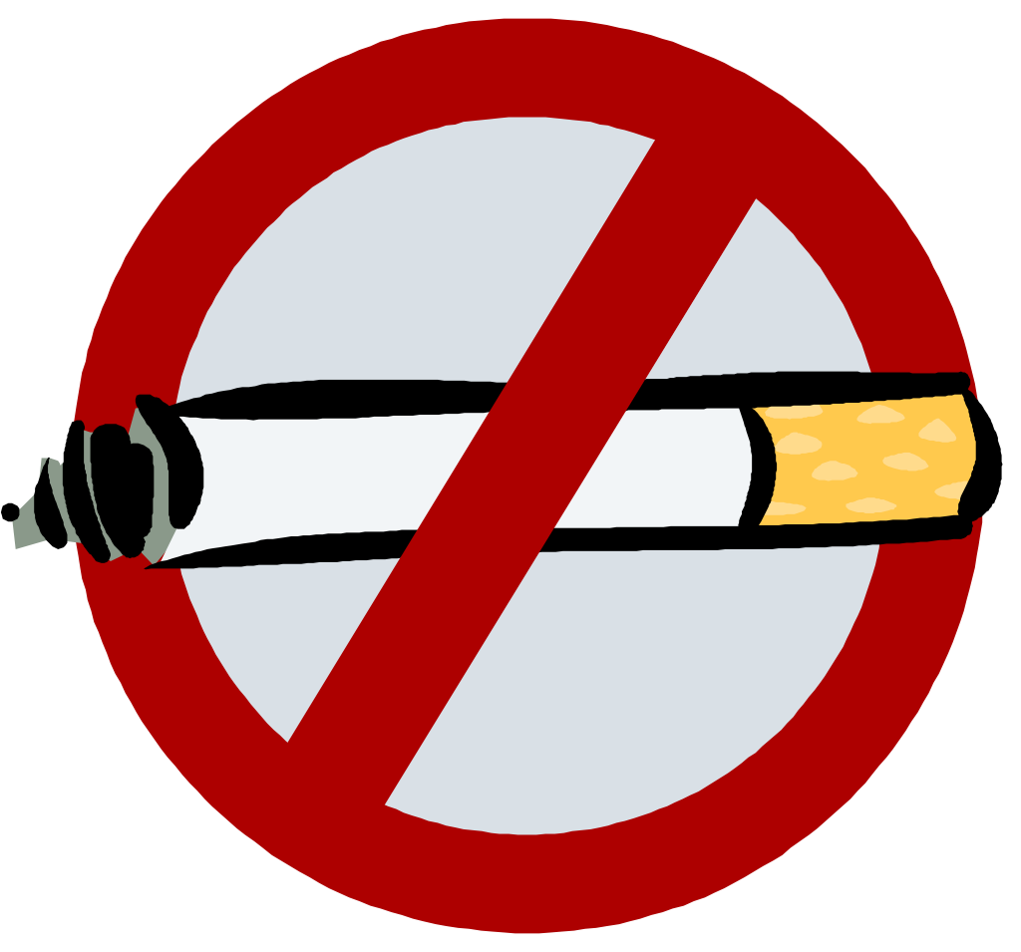
Housekeeping
Safety
  Building exits / emergency plans
Location of rest rooms
Parking
Liability releases
Medical Eligibility Forms
IANTD membership (optional)
Course fees
Cell phone - off please!
5

Slide 6
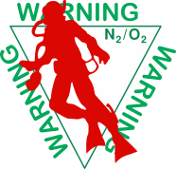
Course Overview
I will now go over the schedule with you so we understand where and when we need to be.
  Academic Requirements
  Land drills
  Confined water training
  Open Water dives
Students demonstrating unsafe diving practices or unsafe attitudes will not be certified!
6

Slide 7
Advice
The sport of SCUBA diving has many hazards:
  From the first time you put a regulator in your mouth and descended below the surface of the water you began accepting the risk that one of these hazards might seriously injure or even kill you.
  As your skills and experience progressed beyond that of an entry-level diver, you began choosing to make more advanced dives, and accepted the greater risks that went with them.
  In the IANTD X-CCR diver class, where exposure to diving environments are part of the curriculum, the risks are relevant.
7

Slide 8
Learning Objective
It is intended that this course enhance participants knowledge and familiarity of Closed Circuit Rebreather Diving and expose divers to concerns when dealing with normal diving environments. By the end of this lecture and practical session you will be diving these configurations more safely and with greater enjoyment.
Your participation in this course should be part of a seasoned, carefully planned and informed progression.
8

Slide 9
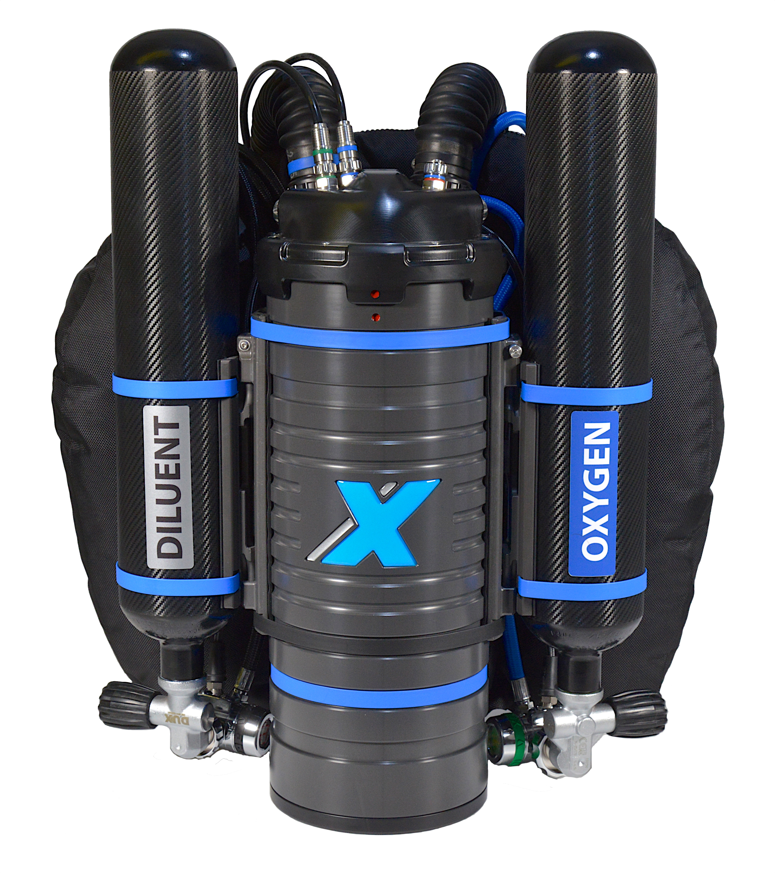

Prerequisites
Minimum 18 years of age
Certified as IANTD Advanced Nitrox Diver or Advanced Recreational Trimix (may be taken in conjunction with Instructor approval), or equivalent
9

Slide 10
Certification Limitations
Diver qualified on specific rebreather
  X-CCR Closed Circuit Rebreather
Diver qualified within the sport diving depth and time limits
  Depth 140 fsw (42 msw) for Advanced EANx qualified
  Depth 160 fsw (48 msw) for Advanced Recreational Trimix qualified
  Decompression stop time not greater than 15 minutes
Training is purchased, certification is earned!
10

Slide 11
Program Content
Minimum 500 minutes of confined and open water dive time
At least 6 open water dives
  Three (3) dives must be a minimum of 50 fsw (15 msw) and one (1) of these dives must be a minimum of 100 fsw (30 msw)
  Divers crossing over from SCR to CCR with 20 dives must:
    Complete 420 minutes of confined and open water time and 6 dives
11

Slide 12
Program Content
  From one CCR to another CCR with 12 dives must:
    Have a CCR dive within the last 45 days
    Complete 60 min confined water and 180 minutes of water training with at least three (3) OW dives
X-CCR specific exam
  Minimum score of 80% with 100% remediation of missed questions
  Water Skills evaluation minimum score of 80%
    Theory and practical review to make studuent knowledgeable of mistakes on exam and water skills
12

Slide 13
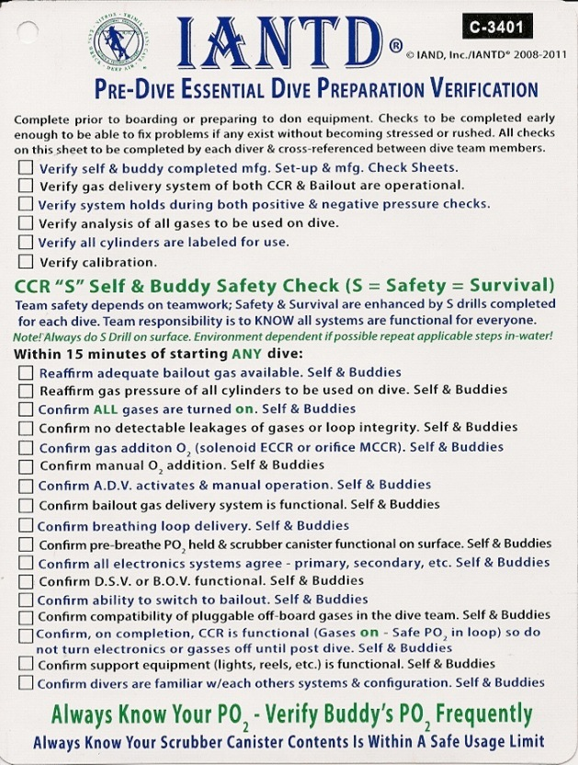
Equipment
IANTD S Drill check sheet C
X-CCR CCR
  Bailout cylinder (off board)
  required on all dives
  At depth, the maximum PO2 of
  gas in diluent cylinder should
  be 1.0 – 1.1 ATA
  This will allow for an adequate
  diluent flush
13

Slide 14
Equipment
Exposure suit suitable for the environment
Back up dive tables
Slate and pencil
Reel and marker buoy
Depth gauge and timer
Knife, Z-cutter or shears
Mask and fins
14

Slide 15
CCR – Mixed Gas
Gas mixed electronically
Virtually unlimited depth capabilities
Very efficient gas supply usage
PO₂ setpoint or continuous oxygen flow
Less expensive to dive especially when used with helium based gases
15

Slide 16
CCR & Partial Pressures
Electronic control system maintains constant PO₂ setpoint
Oxygen sensors detect PO₂ drop & trigger solenoid valve to inject additional oxygen
Remainder of gas in loop is the Diluent which could consist of one or more inert gases
16

Slide 17
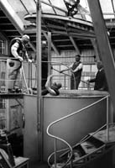
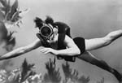
Rebreather History
Early and Recent History
17

Slide 18
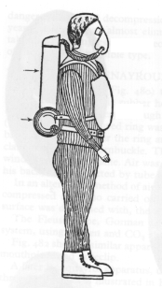
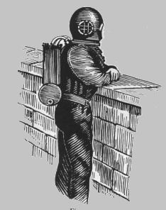
The British Influence ….. SCR
1878
1914
18

Slide 19
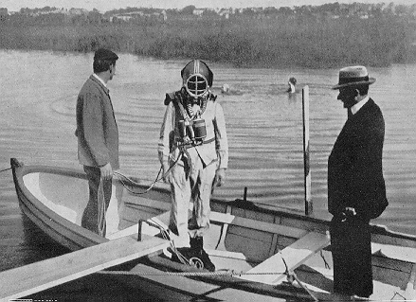
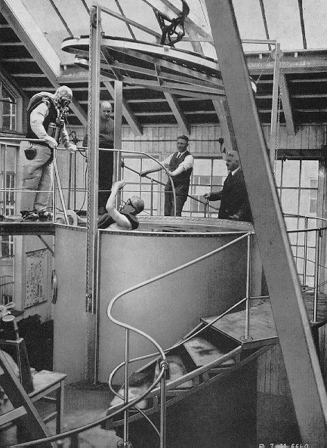
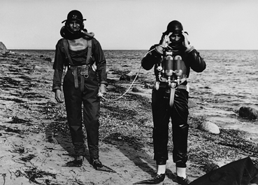
The German Influence …... CCR
1911 – 1914
1941 – 1954
19

Slide 20
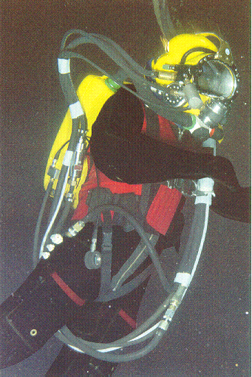
Commercial & Scientific Use
In the 60's and 70's rebreathers are increasingly used for commercial saturation bail-out systems.
20

Slide 21
Early History
17th Century - First conceived by Giovanni Borelli
1878 - First practical system produced by Henry Fleuss
1881 - First CO₂ absorbent used by Khotinsky and Lake
Prior to WWI - Dräger produced systems
WWII - Italian & British Navies used Oxygen and Nitrox systems
21

Slide 22
Recent History
1969 - Electrolung - first practical electronic control Rebreather
Biomarine CCR1000, Carleton Technologies Mk 15/16
Dräger Atlantis 1 1995, Dräger Dolphin in 1998 & DrägerRay in 1999
Cis-Lunar, Inspiration, CCR 2000, Megaladon, Prism Topaz, O2ptima & Evolution
Robust & affordable systems are now available
22

Slide 23
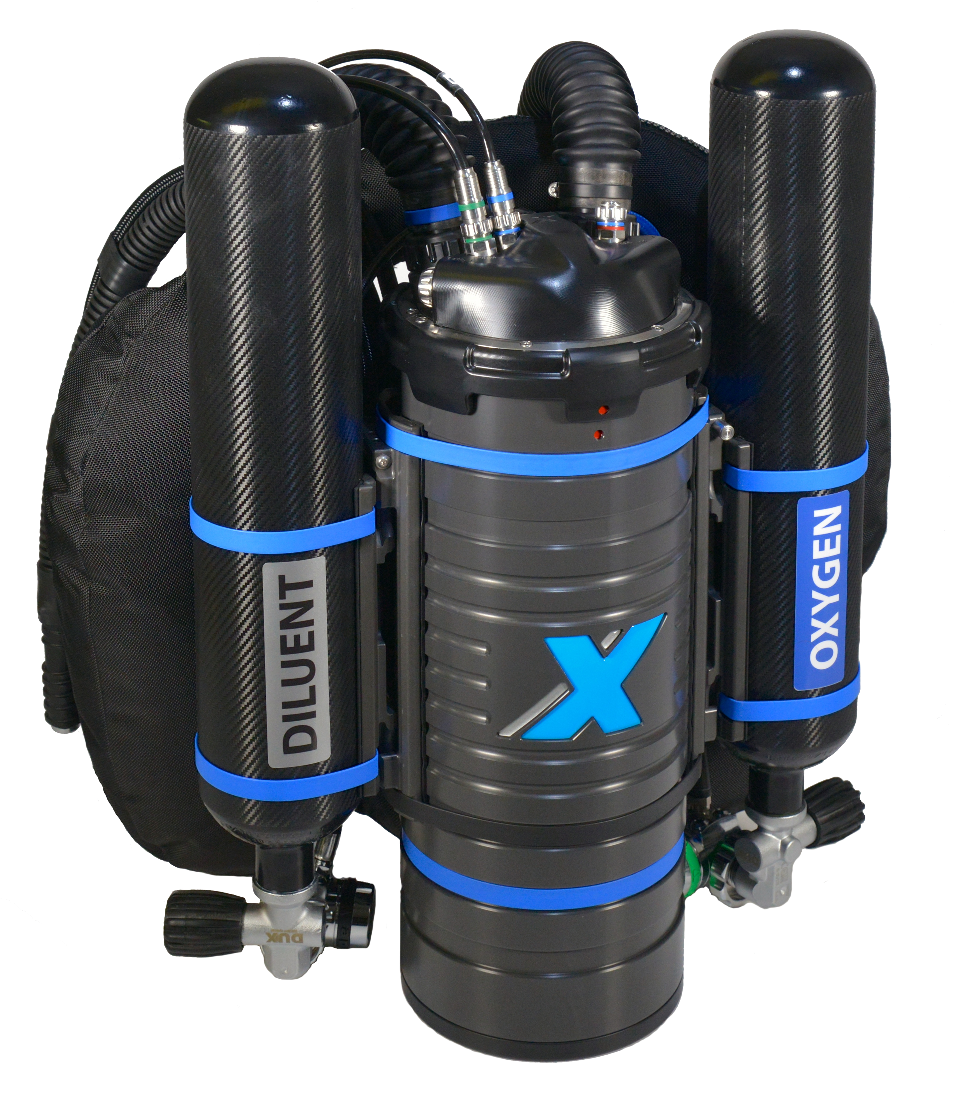
Re-circulating Scuba
Gas supply
Gas control mechanism
Counterlung
CO₂ removal system
Bail-out system
Photo: Matthew Addison
23

Slide 24
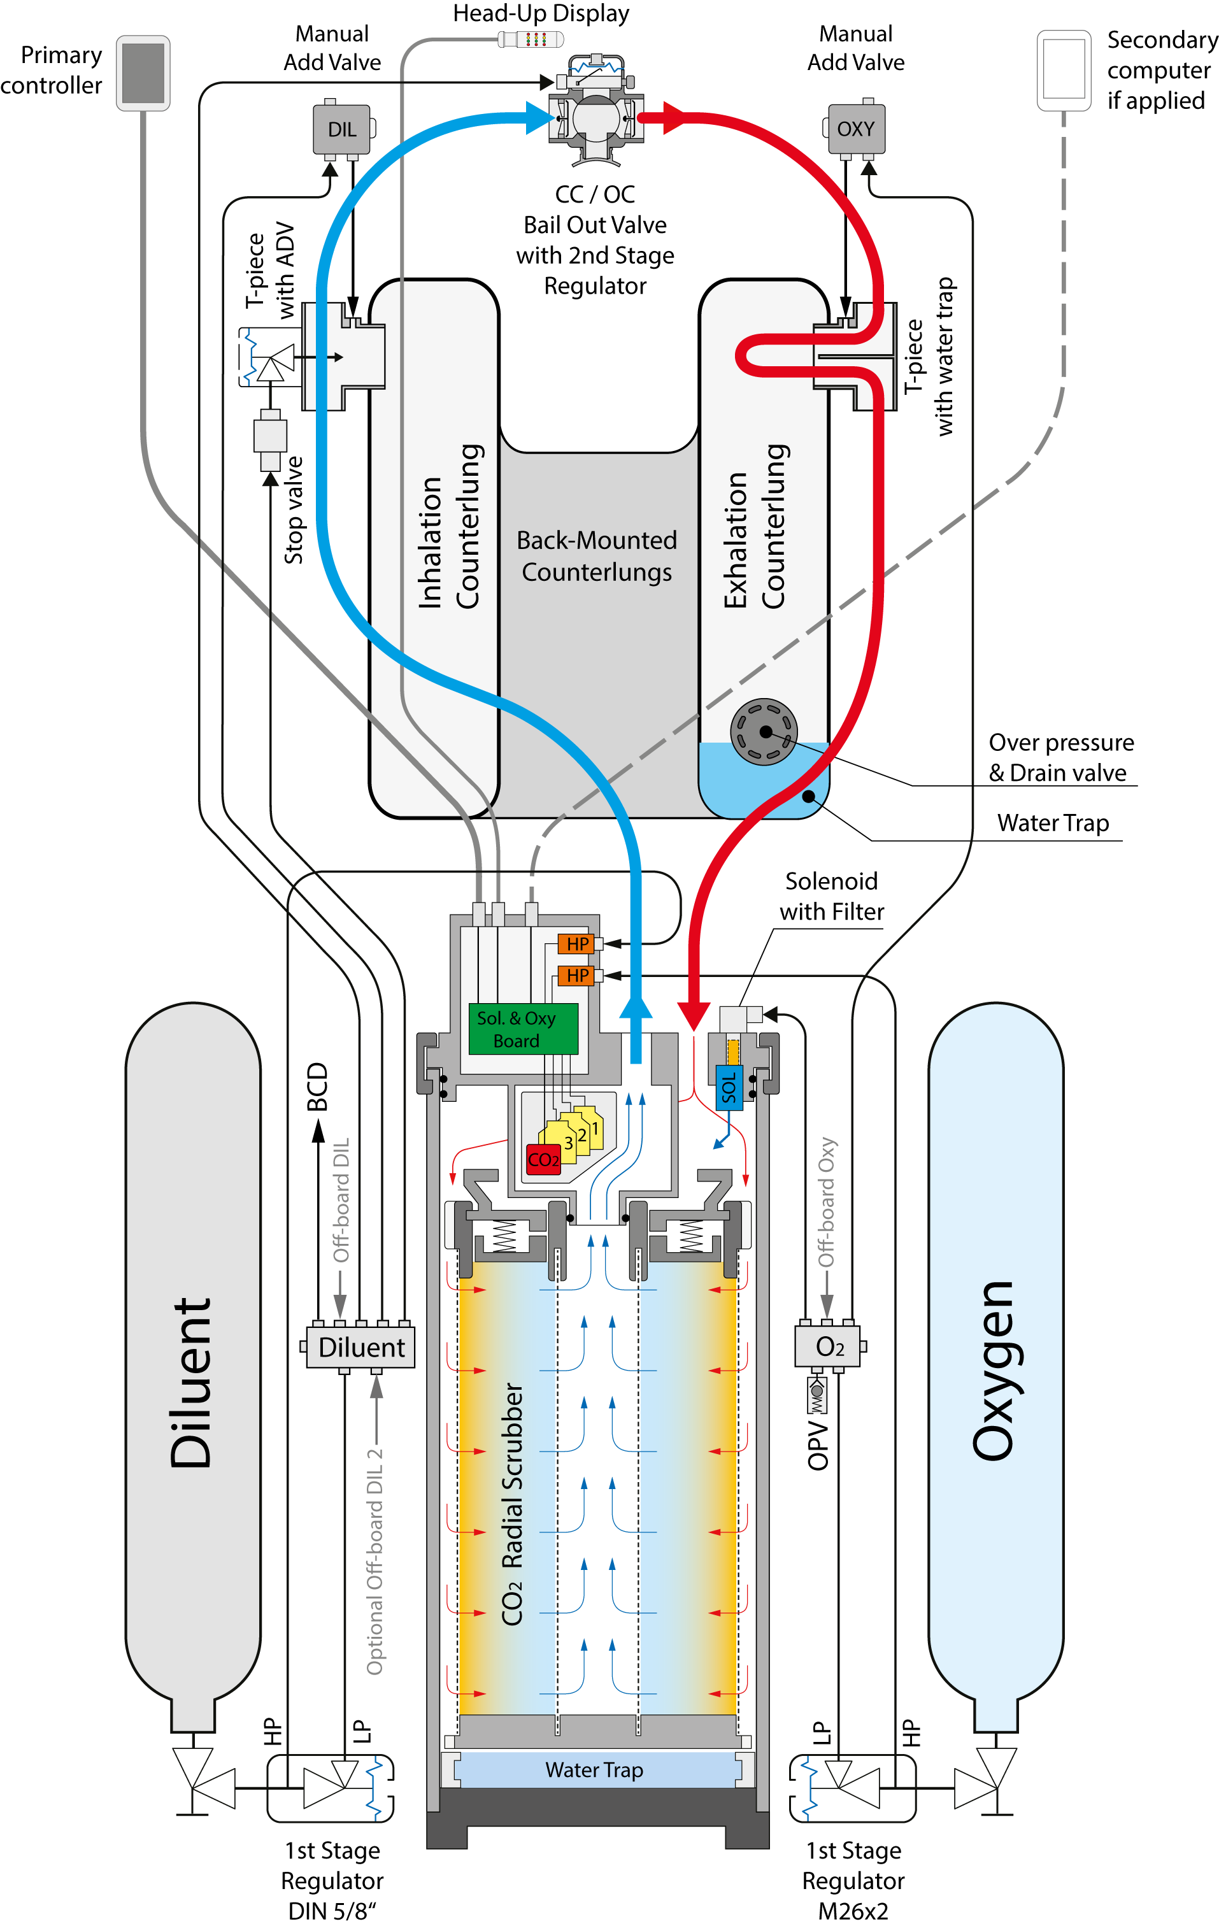
General Design
Diagram od X-CCR
24

Slide 25
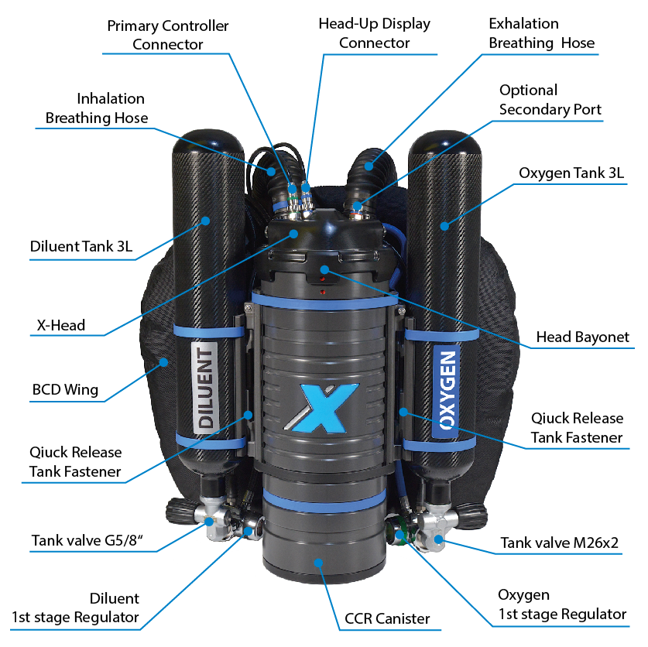
General Design
Overview
24

Slide 26
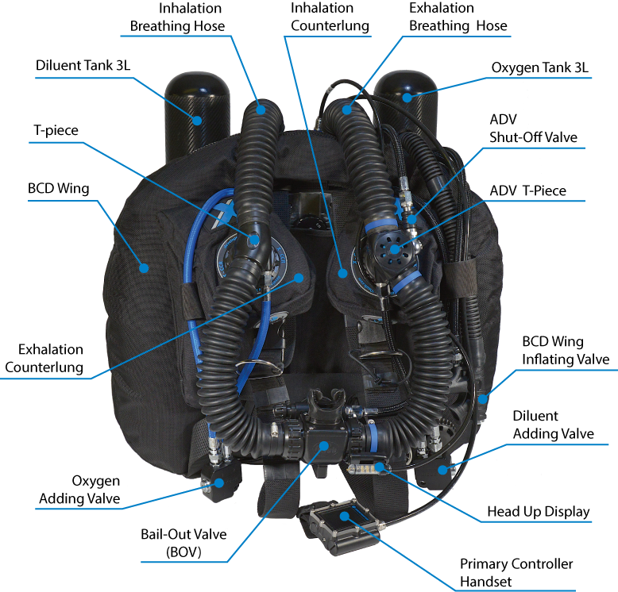
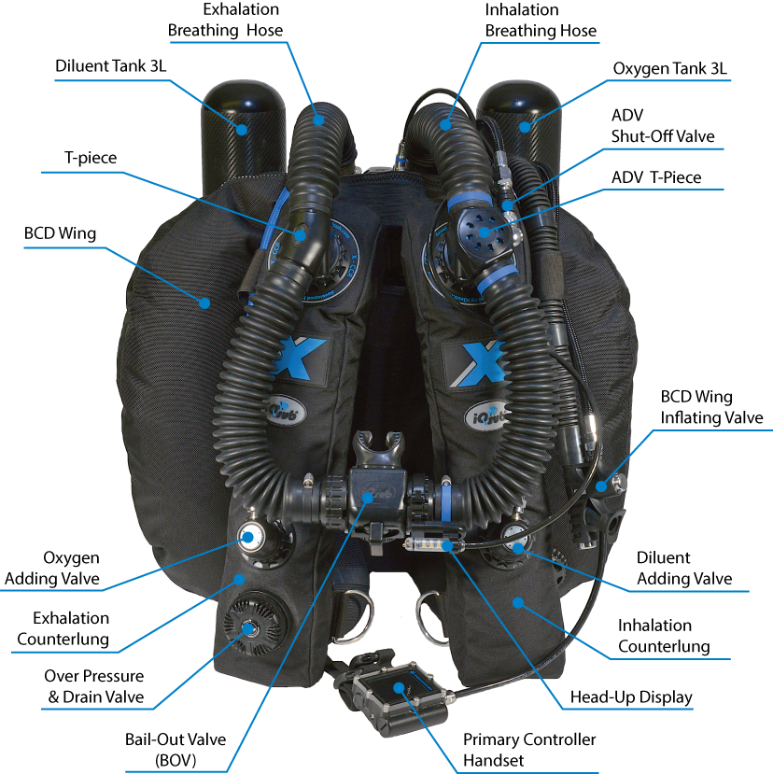
General Design
BM-CL configuration
FM-CL configuration
24

Slide 27
Rules For Safe CCR Diving
Avoid complacency
Avoid distraction
Be a disciplined diver
Be a thinking diver
As the slogan goes always know your PO2
Do not be cheap
Make the CCR your primary diving equipment.
Practice bailout options periodically, assume that any mechanical or electrical device will fail
Accept all emergencies taught during training will happen
Do not start dives with a known system failure
25

Slide 28
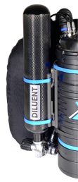
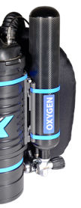
X-CCR Technical Data
Tanks change to appropriate
  Gas tanks optionally from 2L to 7L
  Quick release fasteners for easy and quick tank replacement
26

Slide 29
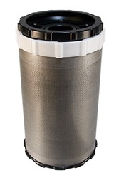
X-CCR Technical Data
Radial scrubber:
  3.3 kg (7,4 lbs) CO₂ absorbent basket
  Use Sofnolime 797, 1 - 2,5mm
  Optional smaller scrubber available
Use assembly checklist
in the user manual
Photo: Matthew Addison
27

Slide 30
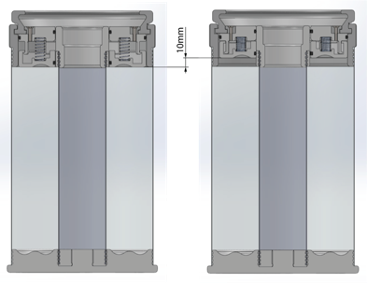
X-CCR Technical Data
The radial scrubber assembled
28

Slide 31
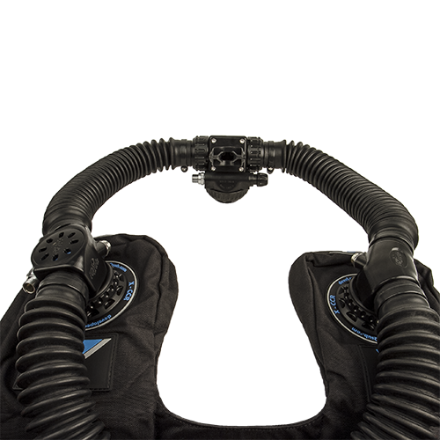
X-CCR Technical Data
Loop
  Back-mounted or Front-mounted Counterlungs
  Click Lock Couples on every breathing loop connection point
  Bail-Out Valve (BOV)
  One way mushroom valves in the BOV ➜ Gas flow direction
  ADV (Automatic Diluent Valve) integrated into T-piece
  Shut-Off Valve (at ADV)
29

Slide 32
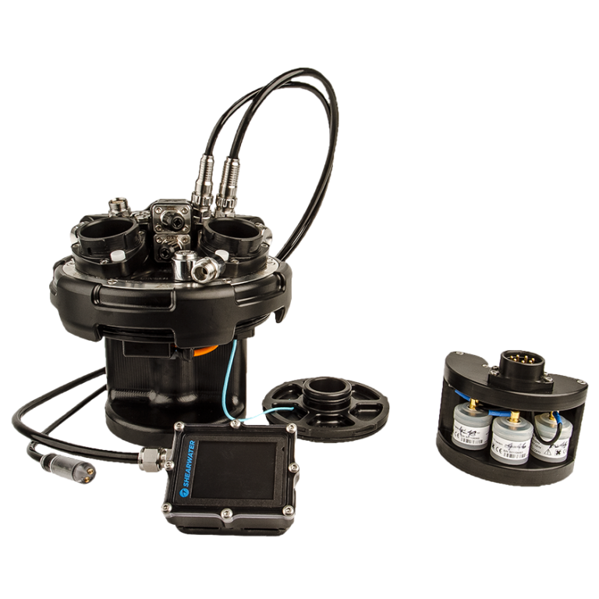
X-CCR Technical Data
Head
  Quick bayonet lock
  Shearwater controller
  HUD
  Flexible secondary
  High pressure sensors
  CO₂ solid state sensor
  Sensor cartridge
  Separete Li-Ion accu 18650
    one for solenoid
    one for HUD
Photo: Matthew Addison
30

Slide 33
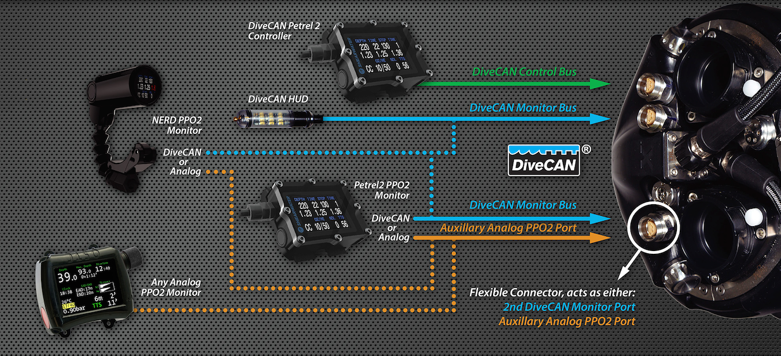
X-CCR Technical Data
Flexible Connection of controlling and monitoring devices
30

Slide 34
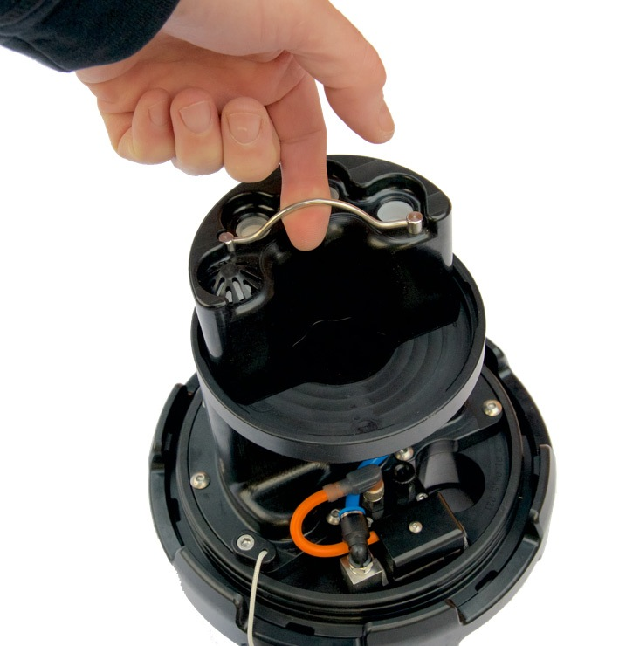
X-CCR Technical Data
O₂ sensors
  Easy removable and swappable sensor cartridge
  3 O₂ sensors
  O₂ sensor should be replaced after one year or after 18 month from its manufacturing date
  NaNS01 Coaxial
CO₂ sensor
  One CO₂ sensor
  Solid state
Photo: Matthew Addison
31

Slide 35
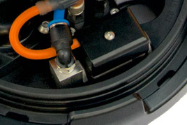
X-CCR Technical Data
Solenoid
  Upstream valve
  Made of AISI 316L
  Rated for up to 17 bar
  With built in O₂ filter in the fitting
  Pre-scrubber O₂ injection
32

Slide 36
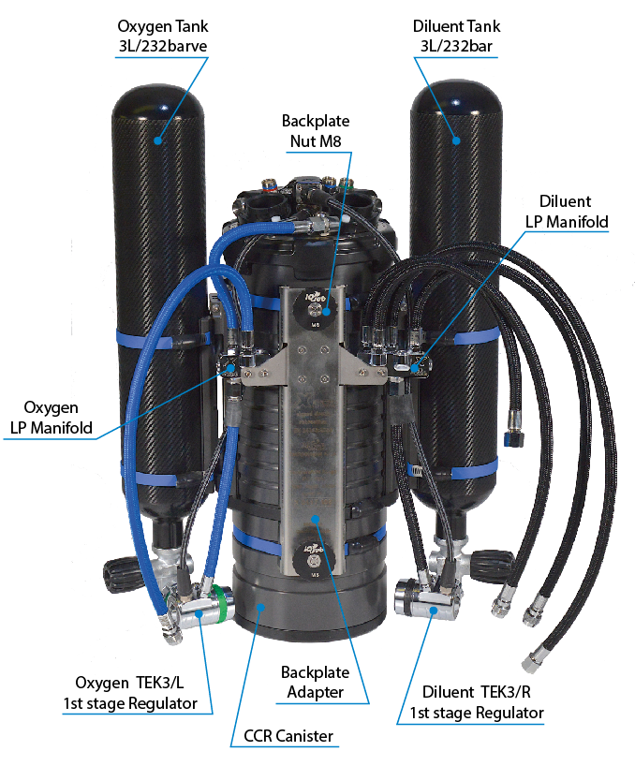
X-CCR Technical Data
Main Body
  Robust aluminum or optionaly derlin canister
  Quick release fasteners for easy replacement of gas cylinders
  Gas cylinders optionally from 2L to 7L
  Diluent manifold with up to 8 outlets
  Oxygen manifold with up to 5 outlets
  Back-plate adapter
33

Slide 37
X-CCR Technical Data
Apeks regulators
  Intermediate pressure
    9.5 to 10.5 bar oxygen regulator
    9.5 to 10.5 bar diluent regulator
Oxygen and diluent MAV (manual add
valve) can also be used to
plug in offboard gas
34

Slide 38
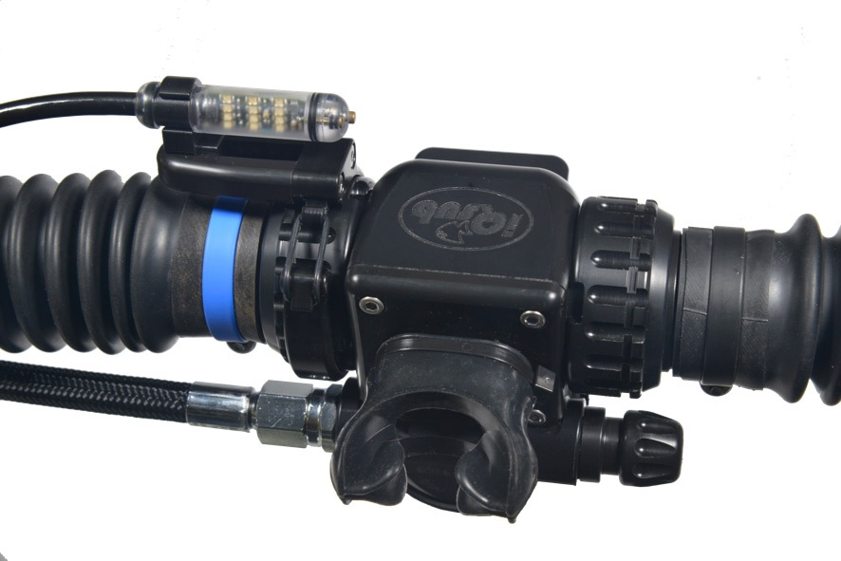
X-CCR Technical Data
Head-Up Display LED signals
  Uses Smither’s analog code showing PPO2 reading of each sensor.
  Flashes yellow over green at pO2 1.0
  Flashes one green for each 0.1 above 1.0
  Flashes one yellow for each 0.1 below 1.0
  Flashes multiple reds for pO2 > 1.6 or < 0.4
Photo: Matthew Addison
35

Slide 39
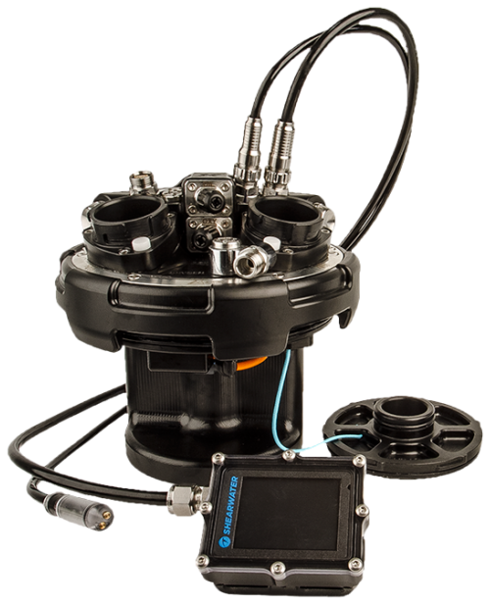
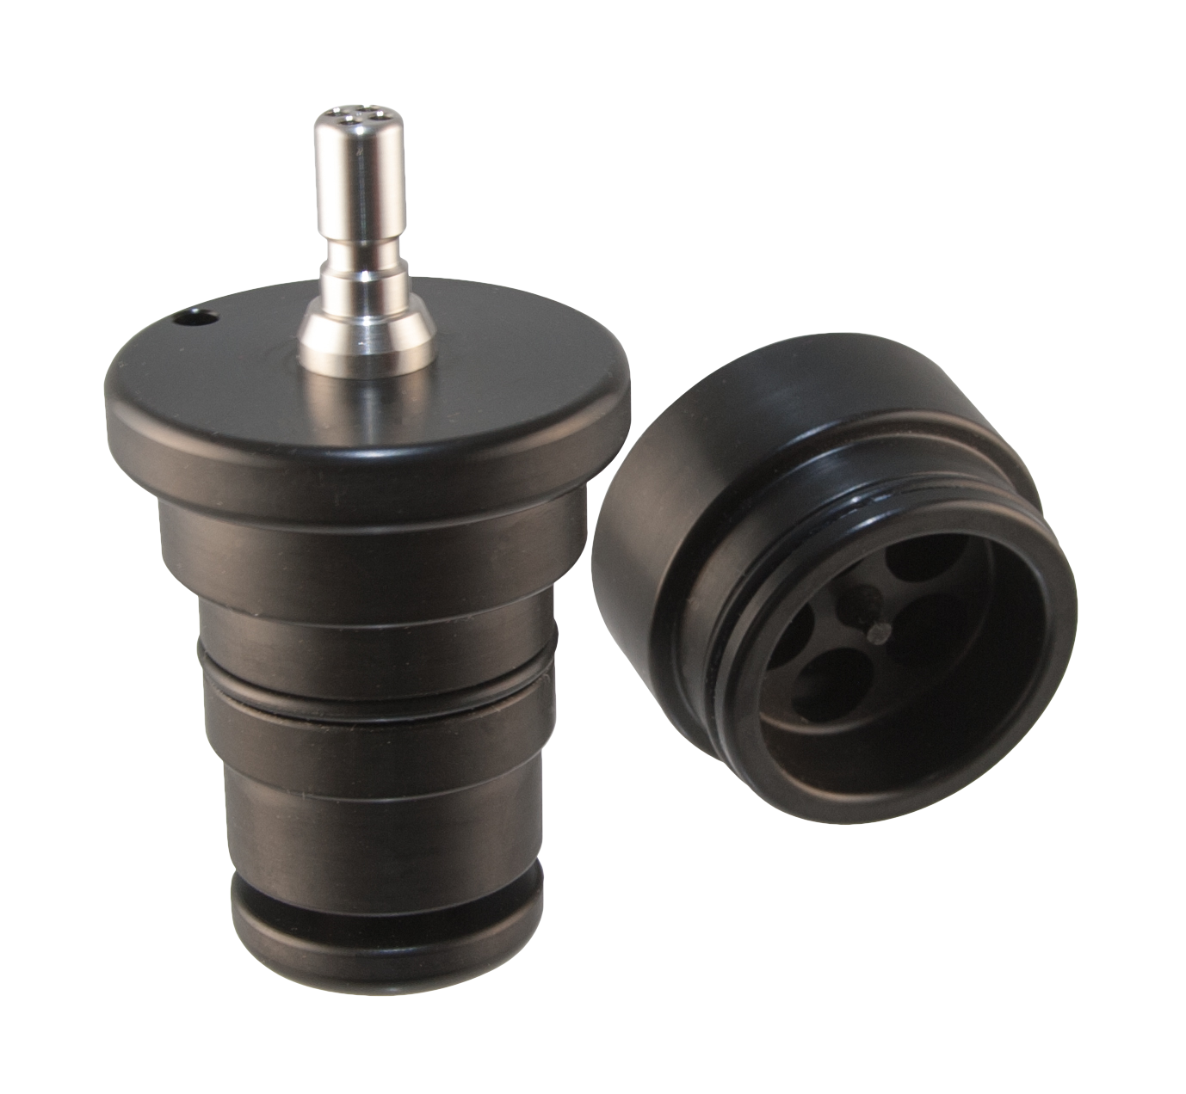
Calibration
Use Oxy Calibration Kit
Oxygen only fills chamber of sensors to save gas
Shearwater controller calibration
HUD calibration
Secondary calibration
36

Slide 40
X-CCR – Doing the Math
Checking the linearity of the O₂ sensors
  Linearity is checked to see if the output of the cell will track the O₂ increase in a linear fashion (no "humps" or "valleys" of mV output) from 21% to 100% O₂
Checking O₂ sensors for current limiting
  Current limiting is done either in a pressure pot or at a depth sufficient to increase a pure O₂ loop to a PPO₂ to 1.6
  This is critical as cells get old they will not read high resulting is extremely dangerous diving situations
37

Slide 41
X-CCR – Doing the Math
  Mathematically we can determine what the mV reading should be when the loop is flooded with 100% O₂
    1.0 atm/0.21 atm = 4.76
    i.e.: S1 – 8.3 mV, S2 – 10.1 mV, S3 – 9.5 mV on air
    So mV on 100% O₂ should be:
      i.e.: S1 – 8.3 x 4.76 = 39.5 mV, S2 – 10.1 x 4.76 = 48 mV, S3 – 9.5 x 4.76 = 45.2
38

Slide 42
X-CCR – Oxygen Cells
As oxygen cells age, their current output will slowly decrease. Because of this aging, it is necessary to verify calibration, or re-calibrate prior to use.
X-CCR recommends replacing oxygen sensors one year from their stamped date
Calibration is extremely easy and is performed on the assembled unit
39

Slide 43
Electrical Oxygen Sensors
Critical components - redundancy
Galvanic fuel cells
Lead anode - gold plated cathode - Potassium Hydroxide solution
Lead is oxidized producing small current between anode & cathode
Individually calibrated
Affected by humidity and temperature
40

Slide 44
X-CCR – Interpreting PO₂
The PO₂’s from the 3 Oxygen Cells are the most important data you have to monitor
Compare the PO₂ displays to each other
Note the speed at which the PO₂ changes
Check your PPO₂ once every minute!
41

Slide 45
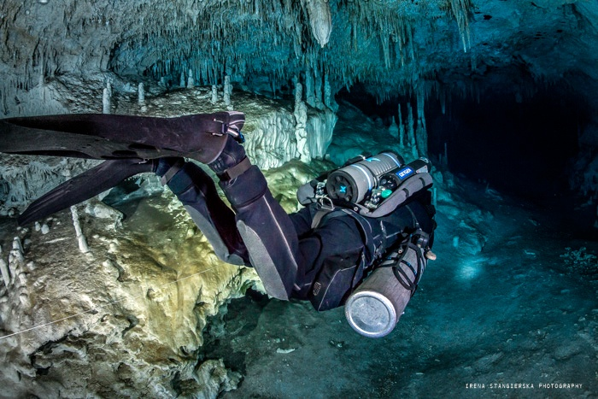
Cylinder Considerations
BCD & drysuit inflation gas will affect Rebreather duration
Diluent used primarily during descents
Oxygen is more likely to limit dive duration
42

Slide 46
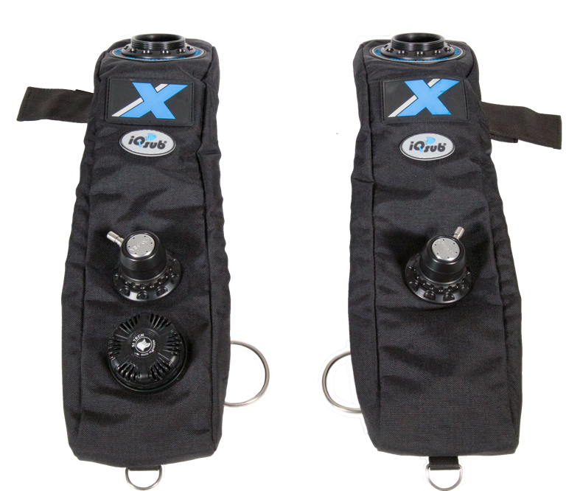
The Counterlung
Necessary for free breathing
  Empty bottle vs. paper bag
Constant Buoyancy
  Exhale: lung volume decreased & bag volume increases
  Inhale: lung volume increases & bag volume decreases
  Compare to Open Circuit Scuba
Position to minimize pressure differential between lungs and counterlung
43

Slide 47
Hydrostatic Effect
Chest mounted bag - diver horizontal
  Inhale less effort
  Exhale more effort
Back mounted bag - diver horizontal
  Inhale more effort
  Exhale less effort
Shoulder mounted bags - most positions
  Inhale & exhale equal effort
44

Slide 48
Breathing Loop
Scrubber for CO₂ Removal
  Exhaled gas passes through this for “filtering effect”
  Efficiency and work of breathing is related to size / types of granules
  Temperature sensitive
  Design also effects the efficiency
45

Slide 49
Absorbent Canister Design
Gas exposed to sufficient surface area of absorbent to remove CO₂
Gas flow rate across absorbent sufficient time (dwell time) for chemical removal of CO₂
Simple & correct packing to prevent ‘channeling’ of absorbent
Prevent excess moisture from reaching absorbent
46

Slide 50
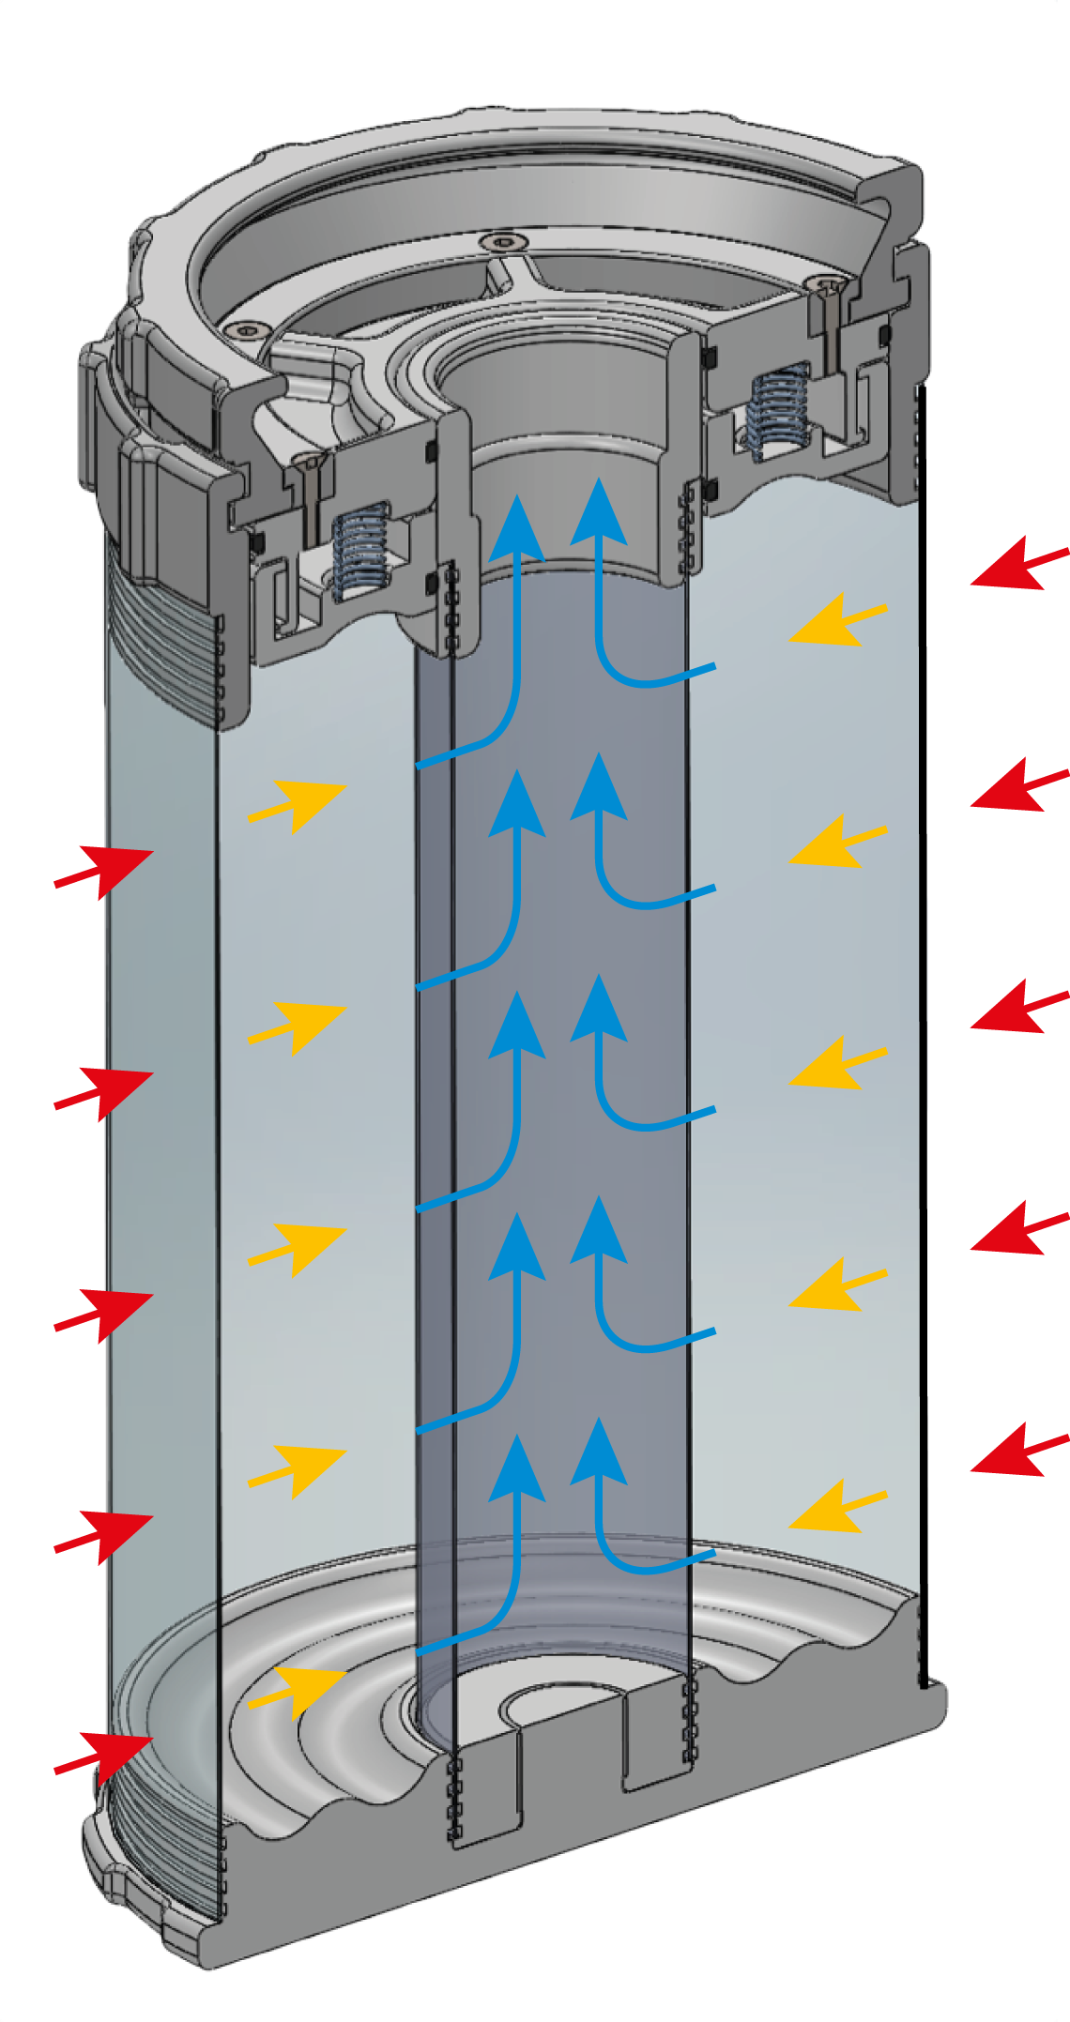
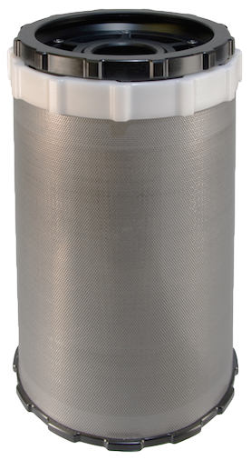
Absorbent Canister
Flow System – Radial scrubber
47

Slide 51
Absorbent Types
Barium Hydroxide - the earliest form of absorbent used
Lithium Hydroxide - long lasting and efficient, but must be carefully handled and is expensive
Soda Lime - a commonly used absorbent available under trade names such as Sofnolime™
All Absorbents will Produce a
Caustic Solution When Mixed with Water!!!
48

Slide 52
Carbon Dioxide Absorption
Typical diving grade soda lime absorbent
  94% Calcium Hydroxide [Ca(OH)2]
  4% Sodium Hydroxide [NaOH]
  <1% Silica (binding agent)
Some types change color with use
Slightly hydrated to ensure production of Carbonic Acid
49

Slide 53
Carbon Dioxide Absorption
CO₂ + H₂O ⇨ H₂CO₃
H₂CO₃ + 2NaOH ⇨ Na₂CO₃ + 2H₂O + Heat
H₂CO₃ + Ca(OH)₂ ⇨ CaCO₃ + 2H₂O + Heat
CO₂ reacts with water (vapor) to form weak Carbonic Acid
Carbonic Acid reacts with base to produce salt (chalk), water & heat
50

Slide 54
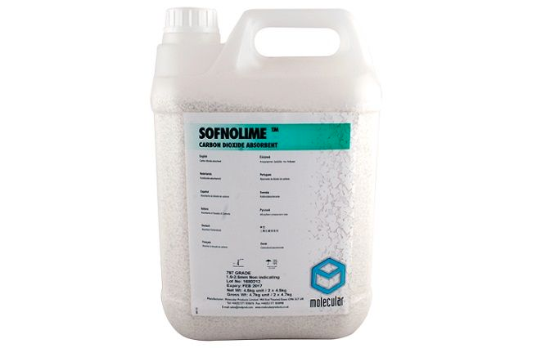
CO₂ Absorbent - Duration Variables
Chemical composition
Canister Design
Canister volume
Temperature
Exertion level
Moisture content
51

Slide 55
CO₂ Absorbent - Materials
X-CCR Scrubber
  Tested under CE conditions
    CO2 production 1.6 liters/min
    Water temperature 4 degrees Celcius
    RMV 40 liter/min
  Standard scrubber
    Duration 5 hours at 100 meters
52

Slide 56
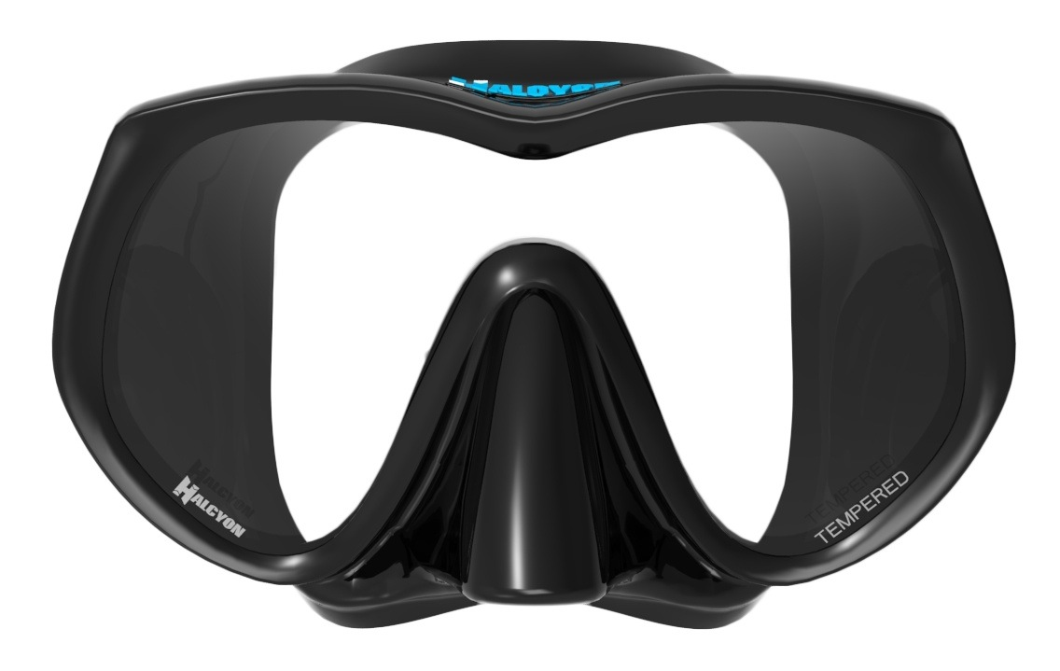
Face Masks
Rebreathers have limited gas supply
Proper fitting mask to prevent leaks
Repeated mask clearing depletes gas supply
53

Slide 57
Breathing Characteristics
More natural breathing than Open Circuit
Breathing resistance depends on location of counterlung and diver’s body position
Water in loop increases breathing resistance
Humid gas reduces dehydration of diver
Warm gas reduces heat loss from diver
Both effects should reduce the risk of DCS
54

Slide 58
Pre-Dive and set up
Complete X-CCR assembly user manual
  Your instructor will follow you through this procedure
  Check off each item in pre dive set up of X-CCR
  Follow the post dive procedures in X-CCR manual
  Refer to and use the maintance log sheet as needed
55

Slide 59
Pre-Dive and set up
Follow both the predive on the check list and the IANTD S drill chart
This can be done at same time
Note The IANTD S drill requires each buddy verifies the other completes the process
56

Slide 60
Pre-Dive
Let us break away from this power point and work with our IANTD C-3401 S Drill Chart
57

Slide 61
Pre-dive Breathe Sequence
Pre-dive breathe for 5 minutes
    Confirm bail-out system operation
    Confirm cylinders on
    Confirm solenoid is keeping pO2 at setpoint
    Operate O₂ manual addition valves
    Confirm O₂ and Diluent pressure gauges
    Confirm BCD inflation and deflation
    Confirm ADV operation
58

Slide 62
Dive Procedures
Initial in-water verification
Descent - diluent addition
Buoyancy control
Monitoring PO₂
Minimum loop volume
Monitoring gas supplies
Ascents
59

Slide 63
Initial In-Water Verification
Check for leaks
Verify PO₂ display working
Adjust buoyancy
Check your dive buddy
60

Slide 64
Descents
Counterlung collapses as ambient pressure increases
  Add diluent to maintain breathing volume
Compensation by diluent gas addition
Rapid descents cause PO₂ spikes
Enter the water with PO2 setpoint of 0.7
Once at depth adjust PO2 to desired setpoint
61

Slide 65
Buoyancy Control
No buoyancy changes during breathing cycle
  Except for oxygen metabolised
Buoyancy adjustments using lung volume therefore not feasible
Counterlung collapses during descent & expands during ascent
Buoyancy change from fully collapsed to fully inflated is considerable
62

Slide 66
Monitoring PO₂
Hypoxia & Hyperoxia are real dangers
Frequent cross checking of both primary & secondary
Constant PO₂ Monitoring is Vital
Check every 1 minute
63

Slide 67
Monitoring Gas Supplies
Gas supplies used at much slower rate than OC but monitoring is still necessary
Small gas supply quickly used if there are leaks in the loop, frequent mask clearing or frequent ascents / descents
O₂ supply not diluent supply, typically limits duration of dive
64

Slide 68
Ascents
Buoyancy changes due to expansion of the counterlung, BCD, and drysuit
PO₂ should not be allowed to drop
Oxygen can be manually added as necessary
65

Slide 69
Physiological Concerns
Hypoxia (O₂ deficiency)
Hyperoxia (CNS O₂ toxicity)
Hypercapnia (CO₂ toxicity)
Decompression Sickness
Chemical Injury
Hypoxia, Hyperoxia & Hypercapnia may cause Loss of Consciousness with little or No warning!
66

Slide 70
Failure Modes
Bail-out Scenarios
  Hypoxia
  Hyperoxia
  Hypercapnia
  Complete electronics failure
    Semi-closed mode
    Minimum loop volume
In an Emergency
Poorly Learned Survival Skills Are Lost First!
67

Slide 71
Hypoxia
Lack of oxygen at cellular level
  First signs at PO₂ of 0.16
  Serious signs at PO₂ of 0.10
Lack of coordination
  Confusion, euphoria, inability to think clearly, unconsciousness & death
Hypoxia Can Lead to
Unconsciousness & Death Without Warning
68

Slide 72
Hypoxia
Procedure
  Switch to Open Circuit for one or more sanity breaths
  Switch back to Rebreather
  Diluent flush
  Check PO₂
  Manually add oxygen to desired PO₂
  Repeat until PO₂ setpoint is obtained
If PO₂ Remains Low, Switch to Open Circuit & Bail-Out
Hypoxia Can Lead to
Unconsciousness & Death Without Warning
69

Slide 73
Hypoxia
Problems that lead to Hypoxia:
  Failure to turn oxygen on
  Manual add valve screen blocked with salt or debris
  Wrong gas in oxygen cylinder
  Failure to calibrate
  Failure to do pre dive Breathe and checks
  Failure to monitor PO₂
  Running out of oxygen supply gas
Mistakes Due To Complacency or Distraction = Accidents or Death
70

Slide 74
Hyperoxia
Excess of oxygen at cellular level
PO₂ of 0.5 to 1.0 ATA/Bar
  Whole Body Oxygen Toxicity
PO₂ > 1.0 ATA/Bar
  CNS Oxygen Toxicity
Convulsions underwater may result in drowning
Hyperoxia Can Lead to
Convulsion & Drowning Without Warning
71

Slide 75
Hyperoxia
Procedure
  If well above set point switch to Open-Circuit for one or more sanity breaths
    If slightly above set point simply flush loop to bring down
  Switch back to Rebreather
  Diluent flush
  Check PO₂
  Repeat until PO₂ setpoint is obtained
If PO₂ Remains High, Switch to Open Circuit & Bail-Out
Hyperoxia Can Lead to
Convulsion & Drowning Without Warning
72

Slide 76
CNS Oxygen Toxicity
Signs & Symptoms
CON | Convulsions
V | Vision
E | Ears, hearing disturbances
N | Nausea
T | Twitching
I | Irritability
D | Dizziness
73

Slide 77
Tracking O₂ Limits
CNS tracking couldn’t be simpler
Use the IANTD O₂ exposure table, at 1.3 ATA you have 3 hours dive time or 3.5 hours/day
Remember, if you push the PO₂ up to 1.4 ATA the dive time is reduced to 2.5 hours or 3 hours per day
Refer to IANTD OTU /CNS Tracking Table C 3201 in the student kit to determine exact oxygen exposure.
Then for repetitive CNS value use the oxygen surface credit chart.
74

Slide 78
Problems that lead to Hyperoxia
High percentage of O₂ in diluent
Solenoid stuck open
Rapid descent started with to high of a setpoint
Adding oxygen during descent
Setpoint maintained too high for dive duration thus exceeding oxygen clock
Failure to calibrate unit
75

Slide 79
Hypercapnia
PCO₂
  0.03 ATA/Bar – doubles breathing rate (dyspnea)
  0.06 ATA/Bar – distress, confusion, lack of coordination
  0.10 ATA/Bar – severe mental impairment
  0.12 ATA/Bar – loss of consciousness, death
Hypercapnia Can Lead to
Unconsciouness & Death Without Warning
76

Slide 80
Hypercapnia
Bailout to OC
Ascend
Hypercapnia Can Lead to
Unconsciouness & Death Without Warning
77

Slide 81
Hypercapnia
Problems that lead to hypercapnia
  Using canister beyond it’s rated /actual duration
  Canister over-breathing
  Wrong material
  Using absorbent that has exceed it’s expiration date
  Absorbent is wet
  Deep diving on partially used canister
78

Slide 82
CO₂ Absorbent Problems
Flooded Canister
  CO₂ absorption fails, caustic cocktail in loop
Absorbent Failure
  CO₂ absorption fails
Switch to Open Circuit Bail-Out
Switch to Open Circuit Bail-Out
79

Slide 83
Moisture In Loop
Always some moisture due to condensation
Accidental removal of mouthpiece
Move water into exhale counterlung
80

Slide 84
Water In Loop
Leaky hose connections, damaged hoses, punctured counterlung & other damaged loop components
Gurgling sound & breathing resistance
Decrease in buoyancy
Clear flooded loop
If problem continues
Switch to Open Circuit Bail-Out
81

Slide 85
Asphyxia
If diver breathes in and out of a closed bag
  CO₂ rises and O₂ falls
Dyspnea - increasing shortness of breath
Breathing difficulties caused by increased CO₂
Death caused by insufficient O₂
82

Slide 86
Complete Electronics Failure
Extreme Emergency - Diver Chooses To Continue Diving Rebreather
  With proper training beyond scope of this course, diver has three options
    Open Circuit bail-out
    Semi-Closed mode
    Minimum Loop Volume while at constant depth
IANTD Recommends Open Circuit Bail-Out
83

Slide 87
External Boom Scenario
Can be classified as gas that is being lost to the environment and not into the loop.
Such loses can include:
  LP or HP hose failures
  Regulator failures
  Tank o-ring extrusions or burst disk failures
IANTD Recommends Open Circuit Bail-Out
84

Slide 88
External Boom Scenario
Procedure
  Turn off both gas supply cylinders
  Look at the diluent and oxygen SPG
  Check PO₂
  Determine which side has failed and what the failure is
  Open the valve of the side that has not failed and abort the dive in either CCR mode or end in OC mode.
IANTD Recommends Open Circuit Bail-Out
85

Slide 89
Internal Boom Scenario
A failure that leads to gas being added to the loop.
These may include the:
  ADV failing in the open position
  Manual oxygen add valve failing open.
  Solenoid stuck in open position
IANTD Recommends Open Circuit Bail-Out
86

Slide 90
Internal Boom Scenario
Indictors are more subtle:
  Increase in buoyancy
  Chipmunk cheeks
  Increased breathing resistance especially on exhalation
  The sound of gas moving
  Increased or decreased PO₂.
IANTD Recommends Open Circuit Bail-Out
87

Slide 91
Internal Boom Scenario
Procedure
  Turn off both gas supply cylinders
  Look at the diluent and oxygen SPG
  Check PO₂
  Determine which side has failed and what the failure is
  Open the valve of the side that has not failed and abort the dive in either CCR mode or end in OC mode.
IANTD Recommends Open Circuit Bail-Out
88

Slide 92
O₂ Sensor Failure
During the dive one or more O₂ sensors can fail
The Shearwater contrtoller will vote out the sensor(s) out of the range
The best O₂ sensor might be voted out
A validation procedure is needed – Diluent flush!
IANTD Recommends Open Circuit Bail-Out
89

Slide 93
O₂ Sensor Failure
Validation procedure
  Do a diluent flush
  Compare the 3 O₂ sensors values with the PPO₂ of the diluent at actual depth
  If the sensor was voted out correctly:
    Follow Shearwater and abort/turn the dive
  If the sensor voted out was incorrectly:
    Abort/turn the dive using the O₂ sensor voted out as parameter of your PO₂
IANTD Recommends Open Circuit Bail-Out
90

Slide 94
Basic Respiratory Physiology
21% oxygen in air at sea level
4% absorbed into blood
  Exhaled air contains approximately 17% O₂
Urge to breathe is triggered by PCO₂
Respiratory rate determined by rate of CO₂ production
91

Slide 95
Basic Respiratory Physiology
Respiratory minute volume (RMV) = total gas ventilated in one minute
  RMV determined by respiratory rate & volume of gas ventilated each breath
OC duration determined by RMV
SCR duration determined by flow rate
CCR duration determined by O₂ metabolic rate
92

Slide 96
Oxygen Metabolism
Oxygen Consumption Varies With Work Load
At rest | 0.3 to 0.5 l/m
Light to moderate work | 1.0 to 1.5 l/m
Heavy work | 2.0 to 2.5 l/m
Maximum work | 3.0 to 3.5 l/m
Increase Gas Efficiency by Rebreathing It!
93

Slide 97
Gas Consumption Comparison
Depth (fsw) | Depth (msw) | Absolute Pressure ATA/BAr | OC lpm | CCR lpm
0 | 0 | 1.0 | 26 | 1
33 | 10 | 2.0 | 50 | 1
66 | 20 | 3.0 | 75 | 1
99 | 30 | 4.0 | 100 | 1
132 | 40 | 5.0 | 125 | 1
165 | 50 | 6.0 | 150 | 1
231 | 70 | 8.0 | 200 | 1
297 | 90 | 10.0 | 250 | 1
94

Slide 98

Closed Circuit Oxygen Metabolism
O₂ supply = 3 liters @ 200 Bar = 600 litres
Metabolic rate = 1.0 lpm @ moderate work load
Assumes no leakage from mask or loop. Duration independent of depth.
95

Slide 99
Open Circuit Gas Usage
X-CCR : 3 litres at 200 Bar = 600 litres
Open Circuit Equipment:
  RMV at surface = 20 lpm
  RMV at 66 fsw (20 msw) = 60 lpm
  600 litres/60 litres per minute = 10 minutes
10 min Open Circuit = 10 hours on JJ-CCR
96

Slide 100
Rebreathers & Decompression
Partial pressure of inert gas determines decompression obligation
Open Circuit & Semi-Closed Circuit
  PO₂ maximum only at target depth
With Closed Circuit constant PO₂ (setpoint) increases decompression efficiency
Dramatically reduces decompression obligation
97

Slide 101
Decompression Efficiency
The most efficient is Closed Circuit Rebreather
The second most efficient is EANx or Trimix Open Circuit
The third is Semi-Closed Rebreather
The least efficient is Air Open Circuit
CCR is the ideal system for decompression
efficiency and ease of oxygen tracking
98

Slide 102
Breathing Gas
Oxygen & Inert Gas % -- Note: X-CCR recommends a high set point of 1.2
Depth (fsw) | Depth (msw) | Pressure (Bar) | PO₂ (Bar) | FO₂ | F_{Inert}
10 | 3 | 1.3 | 1.3 | 100% | 0%
20 | 6 | 1.6 | 1.3 | 81.3% | 19.7%
33 | 10 | 2.0 | 1.3 | 65.0% | 35%
66 | 20 | 3.0 | 1.3 | 43.3% | 56.7%
99 | 30 | 4.0 | 1.3 | 32.5% | 67.5%
132 | 40 | 5.0 | 1.3 | 26.0% | 74.0%
165 | 50 | 6.0 | 1.3 | 21.7% | 78.3%
99

Slide 103
CCR Buddies
CCR Buddy with X-CCR
  Walk through each other configuration to increase safety
CCR Buddy with a CCR other than X-CCR
  If certified as diver on the buddy CCR, just walkthrough each other configuration to increase safety
100

Slide 104
CCR Buddies
  If not certified as diver on the buddy CCR, get to know HOW:
    To close the BOV
    To switch setpoint
    To Switch to OC
    To add O₂ and Diluent manually
101

Slide 105
CCR Buddies
OC Buddy
  Explain that:
    If possible CCR Divers prefers to go around than over the obstacles
    During descent and ascent, CCR Divers have other things to take care
    If he runs out of gas, from which tank he can breathe and how
  Explain HOW:
    To close the BOV
    To switch setpoint
    To switch to OC
    To add O₂ and Diluent manually
102

Slide 106
CCR Buddies
    To interpreted the HUD lights
    You want to be rescue in an emergency
    To do a buddy breathe, in case both divers need to share the bailout gas (Rare but…)
  Walkthrough each other configuration to increase safety
103

Slide 107
Chemical Injury
Caustic cocktail
  May produce mild irritation to third degree chemical burns
  Some absorbents may be lethal if wet (Lithium Hydroxide for instance)
Battery related injuries
Electrical injury
104

Slide 108
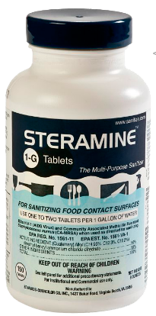
Rebreather Maintenance
Disinfecting & cleaning
O-rings
Hoses
Counterlungs
Scrubber Basket
105

Slide 109
After Each Day Of Diving
Vent O₂ sensors to the atmosphere
Let the sensor head dry out
Drain exhale counterlung
Sterilize the full breathing loop after each day of use
Re-pack absorbent, fill cylinder as necessary
106

Slide 110

Post Dive & Storage
Rinse exterior of unit
Remove/dispose absorbent
Clean scrubber canister
Rinse/disinfect counterlungs & hoses
For storage, leave cylinder partially filled
Allow unit to dry, lubricate all O-rings
107

Slide 111
O-Rings
Do not disturb O-rings unnecessarily
Carefully inspect prior to reassembly
Replace damaged O-rings
Excessive lubrication not required
Check O-ring grooves for damage
O₂ compatible lubricants only
Factory sealed compartments - don’t tamper
108

Slide 112
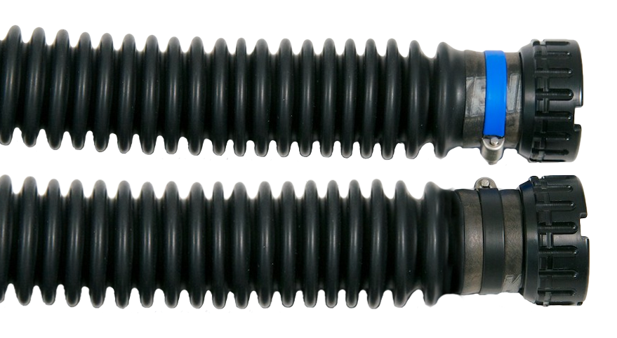
Hoses
Check for visible damage after every dive
Store in hard carry case
Do not carry unit by hoses
Do not place heavy equipment on hoses
109

Slide 113
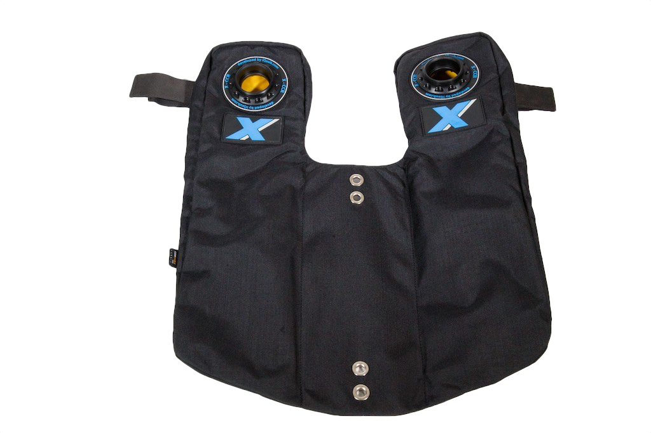
Counterlungs
Check loop interface ports for damage to threads, etc.
Keep dry (vented) when not in use
110

Slide 114
Summary
Advantages of Rebreathers greatly outweigh the disadvantages
Correct training is obligatory
The X-CCR is a safe and effective means of CCR diving
Always Know Your PO₂
Be Sensible, Be Safe!
111

Slide 115

Do you have any questions for me?
Would you please fill in a course critique?
Let’s go DIVING!
112

